Slide 1

EXCEL CAPSTONE PROJECT: ANALYSIS OF FLEXTRADE USER EXPERIENCE FOR INFORMED BUSINESS DECISION MAKING
BUNMI AROKOYU

Slide 2
INTRODUCTION
Overview of Flextrade
FlexTrade is a well-known company in the online shopping world they sell all kinds of things, from electronics to clothes.
Problem
The major problems faced by Flextrade include:
High bounce rate
Industry Competition
Cart abandonment
Low verage order value
Objective
Analyse Flextrade user datasets and derive insights and recommendations that would enable Flextrade make informed business decisions to increase reduce bounce rate, cart abandonment as well as stay ahead of competition in the industry.

Slide 3
MATERIALS AND METHODS
The dataset for the analysis was downloaded from the 10ALYTICS Classroom page. The dataset was in three excel sheets namely App Analytic Data, User Behaviour Data and User Feedback data in .xlsx format.
Prior to the analysis, the three dataset were merged into a single sheet using the VLOOKUP function leveraging on the primary key (unique identifier) common in the datasets.
Microsoft Excel tools including Pivot table, Pivot chart were used for the analysis and report

Slide 4
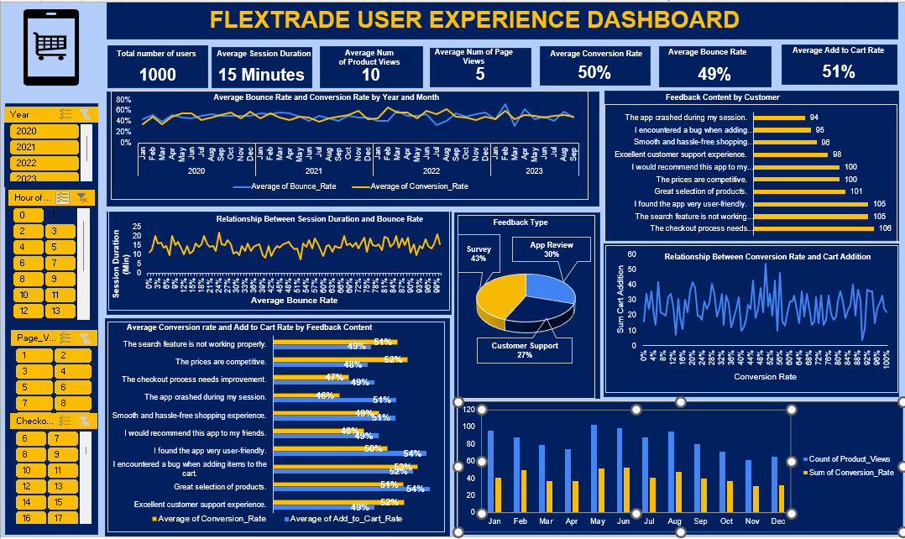
RESULTS
This dashboard provides the summary of the FLEXTRADE User Experience Analysis
Figure 1

Slide 5
CASE STUDY 1
The dataset was checked for duplicate using the DELETE DUPLICATE option on excel home DATA RIBBON.
No duplicate entry was found in the dataset, this implied that each role represents a unique customer experience.

Slide 6
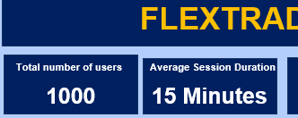
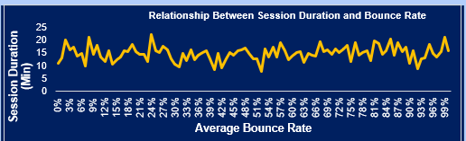
CASE STUDY 2
The Average duration a typical user spend on the App is 15 Minutes as shown in Figure 2 below.
Figure 2
Shorter sessions are not associated with higher bounce rates. The relationship between session duration and bounce rates is not a linear one. Generally, customer who spend shorter session duration of between (5 to 10 min ) have 40-55% bounce rate from the app while the customers who spend more time on (20-25 min) on the app have between 9 and 25 % bounce rate as shown in Fig 3.
Figure 3

Slide 7
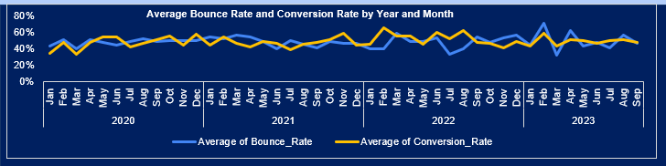
CASE STUDY 3
There is no significant relationship between bounce rates and Conversion Rates. In 2022, the Average conversion rate was higher than bounce rate in February, June and August. In 2023, however, the average bounce rate is higher in February, April and August as shown in figure 4.
Figure 4

Slide 8
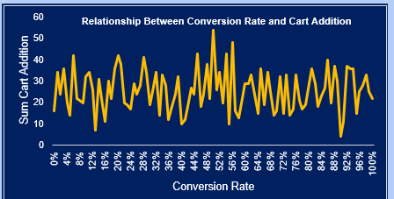
CASE STUDY 4
At around 48- 58% conversion rate, customer typically have higher number of goods added to cart than at other conversion rates. At higher conversion rate of 85%-92%, user adds lower number of items into the cart.
Figure 5

Slide 9
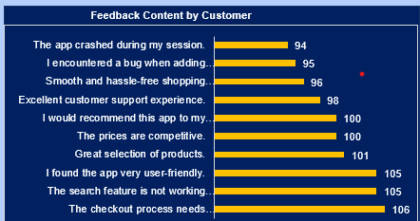
CASE STUDY 5
The common themes in the customer feedback content is shown in Fig 6.
The checkout process needs improvement , the search feature is not working properly, and I found the app very user friendly being the most common feedback reported by 106,105 and 105 customers, respectively.
The app crashed during my sessions, and I encountered a bug when adding items to the cart were reported by 94 and 95 customers, respectively.
Figure 6

Slide 10
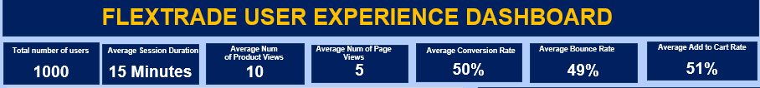
INSIGHT
Flextrade has a total of 1000 users and an average bounce rate of 49 %, this is higher than average ecommerce industry bounce rate of 20-45% (Shopify, 2023).
The Add to cart rate is 50%, while the industry standard is 3-5% and good ACT is between 8-10%.
A typical user uses average 15 minutes on the app. While the average number of page view is 5, the average number of products view is 10.
Figure 7

Slide 11
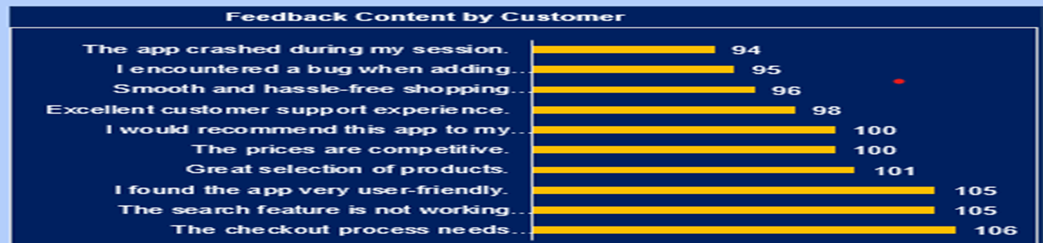
INSIGHT
The checkout process needs improvement , the search feature is not working properly, and I found the app very user friendly are the most common feedback reported by 106,105 and 105 customers, respectively. Whereas, The app crashed during my sessions, and I encountered a bug when adding items to the cart were reported by 94 and 95 customer respectively.
Figure 8

Slide 12
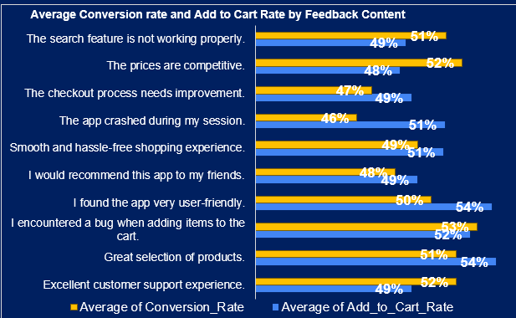
INSIGHT
The customers with positive feedback content have higher average add to cart rate and conversion rate than customers with negative feedback content vice-versa.
Figure 9

Slide 13
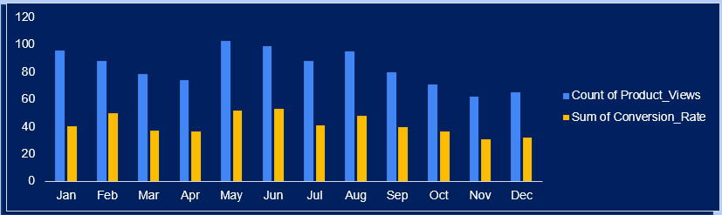
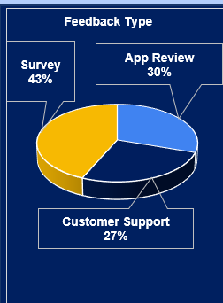
INSIGHT
Highest number of products are viewed by customer in the month of May, June July and August, the highest number of items were sold in these month.
Figure 10
The Survey is the most common feedback type among customers.
Figure 11

Slide 14
RECOMMENDATIONS
To improve bounce rate
Optimise search feature such as product description and images enhancement.
Make add-to-cart button stand out (colour-wise) and include this on every page.
Simplify navigation
Exit-intent pop up could also
be incorporated when customer tries to leave the site.
Utilize cloud computing technology to optimize
load speed, network and application to work efficiently.

Slide 15
RECOMMENDATION
To improve add to cart rate, product view and conversion rate
Target promotion and adopt pricing strategies discount, free shipping in the month of June , July and August.
Add reviews about products strategically, as it can quickly help customer to decide about the product.
Simplify check out process by giving options for next day delivery, payment option and collection centre.

Slide 16

RECOMMENDATIONS
To increase the total number of customers
Flextrade should consider Referral Bonuses scheme such as refer 3 friends and get bonus
Advertisement and promotions
Expand their product base

Slide 17

THANK YOU

